Slide 1
X-Ray Image Recognition for COVID-19
Team: David Arno, Animesh Danayak, Michael Harris, Wei Jiang, Emily Teng

Slide 2
Table of contents
01
02
03
Our Product
Data and ML Model
Differentiators
04
05
06
Path to Profitability
Investor Opportunity
Conclusion

Slide 3
Our Product
What is it: SaaS product serving hospitals and research facilities.
Use case - Image Recognition: Using Lung X-Rays, we are able to determine if a patient is inflicted with COVID, Pneumonia, Lung Opacity, or if they are healthy.
Notes:
Can adopt to real-time processing from inputting X-Rays, processing data, evaluating results, and reporting.
The software can be integrated into EHR(Electronic Health Record) systems.
How it works: Automatic annotation and interpretation of X-Rays.
How it works: Automatic annotation and interpretation of X-Rays.
SaaS product serving hospitals and research facilities. The product is intended to be a tool for providers and researchers to facilitate medical diagnosis for patients.
The software can be integrated into EHR(Electronic Health Record) systems.
The software can be integrated into EHR(Electronic Health Record) systems.

Slide 4
Data
X-Ray Images provided by a team of researchers from Qatar University and the University of Dhaka, in collaboration with medical professionals.
Notes:
Source: https://www.kaggle.com/tawsifurrahman/covid19-radiography-database
What Wei just described, requires input DATA. We were able to procure a trove of X-ray images made available by a team of researchers at the Qatar Dhaka universities in close collaboration with medical professionals.

Slide 5
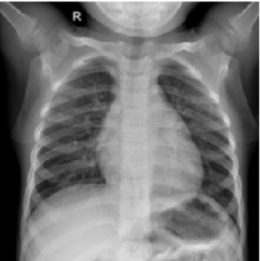
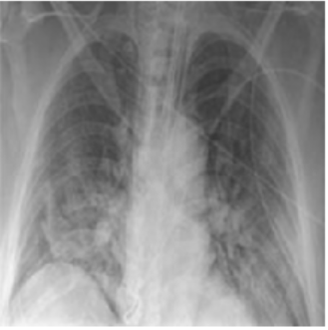
X-Ray Images
NORMAL
COVID-19
Notes:
So, what is the input to our model? To your or my leyman eyes, there is hardly any difference between these two X-ray images. But to a professional, an indicative nudge that the right X-ray belongs to a covid patient makes their decision making process faster and accurate and that could be the difference between life and death!

Slide 6
Machine Learning Model
Input data
Model training
Output
X-Ray images of patients with:
Normal lungs
COVID infected
Pneumonia
Highly opaque lungs
Multi-class Convolutional Neural Network trained on Google’s Tensorflow library
Probability of patients with:
Normal lungs
COVID infected lungs
Pneumonia
Highly opaque lungs
Notes:
We deployed the available X-ray images and trained a Convolutional Neural Network on Google’s Tensorflow. This multiclass classification model, predicts whether a given X-ray image corresponds to a COVID infected patient or patient with viral pneumonia or patient with highly opaque lungs or whether the lungs are functioning normally.
Given a new X-Ray, our model provides the probability that the lungs are infected with COVID, infected with viral pneumonia, have high opacity, or belong to a normal patient with healthy lungs..

Slide 7
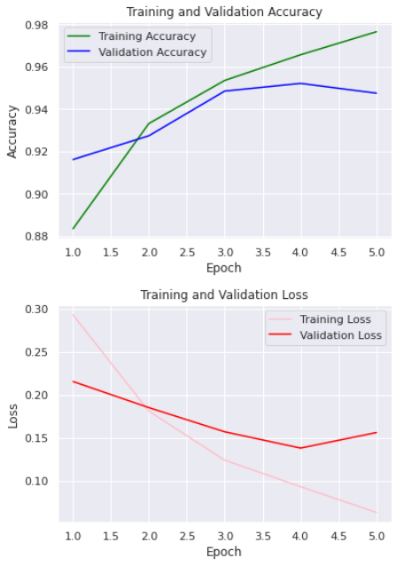
Results
“
Training and Validation:
We split the input data into training and validation samples
A hold-out validation sample helps establish model’s performance
Model Evaluation:
Accuracy: 95%
Loss: 15%
Notes:
We split the data into training and hold-out validation samples. Having a validation samples helps in improving the out of sample accuracy of the model - lesser surprises for the model when deployed!
As we can see from the graphs, with increasing iterations aka. Epochs, the accuracy of the training and the validation models INCREASE. The graphs also point at the reducing loss value with the increase in the number of iterations.

Slide 8
Our Differentiators
Diagnosing more than one Disease
Ease of Use
Low Cost
Notes:
We have found 3 ways we have differentiated ourselves from competitors
Our product can diagnose the likelihood of multiple diseases including pneumonia, or high lung opacity, in addition to screening for COVID.
Ease of Use. Our product is easily operable by even non-technical professionals. The only work needed is an image upload to our model.
Because our model has already been trained and requires little upkeep, there is little cost associated with use. That’s why we are able to provide our product at the lowest prices on the market.

Slide 9
Path to Profitability
Scales efficiently. The same service is provided to all customers.
Target underserved markets
Provide more services trained on client data
Notes:
Scales very well. Most cost will go into training the models, so that expanding to more customers will be low cost
Currently, machine learning solutions have not been widely adopted outside the United States. Therefore major international markets are available for targeting.
More customers allow for more training data for our models. This will increase the accuracy of our product. It will also provide opportunities to expand into more services for a variety of diseases.
Next, Michael will talk about the investment opportunity
https://cardio.ai/#/whycardioai
(Emily) included this link for reference because it talks about using AI/ neural networks for ECG diagnosis (similar to what we’re doing with x-rays) and also 1) remote patient monitoring / health surveillance and 2) integration into an electronic health record system that can be tailored for a wide variety of healthcare applications.

Slide 10
A Great Investment Opportunity
Continuous Demand: Not very affected by economic downswings.
Low Operational cost: Minimal upkeep costs.
A growing industry: Doctors are increasingly relying on AI for diagnoses, and the market is rapidly growing.
“The healthcare market for AI is increasing at a rate of 40% and is expected to reach 6.6 billion by 2021. ^{[1]}
Notes:
Ahuja, Abhimanyu S. “The Impact of Artificial Intelligence in Medicine on the Future Role of the Physician.” PeerJ, PeerJ Inc., 4 Oct. 2019, www.ncbi.nlm.nih.gov/pmc/articles/PMC6779111/.
So - why is our company a great investment opportunity?
Well, healthcare is a field that isn’t very affected by economic downswings. No matter how the rest of the economy is doing, there will be a continuous demand for medical services, and for our product.
Additionally, there’s a low operational cost. The primary costs that our company has are in acquiring data, in training our model, and in distributing our software to our clients. This minimal cost ensures that we can retain profitability even in a competitive market.
Lastly, I’d like to point out that AI for Healthcare is a growing industry. Read quote. Investing in our company ensures that you’ll be investing in a growing field, with a steady source of demand and low operational costs. And now, I’ll hand it over to Emily to discuss our conclusions and future steps.

Slide 11
Conclusion
“
Our Automated X-ray Image Classification service
Saves costs and time
Enables large scale processing
Can potentially expand to other types of medical diagnoses
Unleashes new research and industry applications
Deep learning in medical data analysis is here to stay.
Future directions:
Work with larger datasets to better train the model for multi-class recognition and to improve generalizable performance.
Employ and improve data protection practices.
Notes:
Work with larger datasets (with greater variety of lung conditions, etc.) to better train the model for multi-class recognition and to improve the generalizable performance of our model.
Since we are using sensitive medical data, we are looking into strengthening our data privacy practices such as integrating frameworks for federated learning or differential privacy

